Slide 1

This lecture is being recorded If you feel uncomfortable, you can turn off your camera and microphone
Lund University | Master's programme in Bioinformatics| BINP16 Bioinformatics: Programming in Python | Dr. Sara Behnamian| October 2021

Slide 2
LEARNING OBJECTIVES
1. OOP - Object Oriented Programming
Class-Definition
Object-Definition
Apply OOP to Video Games
Instance-Definition Practice OOP Coding
2. Inheritance and Composition
Practice

Slide 3
Object-Oriented Programming OOP is a way of writing programs by bundling data and functionality into objects. Object-Oriented Programming is a programming paradigm that relies on the concept of classes and objects. It is used to structure a software program into simple, reusable pieces of code blueprints (usually called classes), which are used to create individual instances of objects. The Objects in OOP Objects are entities that bundle data together with properties we think of as the objects' “behaviors”. The data are organized into attributes and the computations into methods. Objects are typically mutable: Methods can modify (the state of) the attributes of the objects on which they’re called. Everything is an object, numbers, strings, list, etc. Even classes are objects. Nothing is private.

Slide 4
Classes
A class is like an outline for creating a new object. An object is anything that you wish to manipulate or change while working through the code. Every time a class object is instantiated, which is when we declare a variable, a new object is initiated from scratch.
In other words, a class is an abstract blueprint used to create more specific, concrete objects. Classes often represent broad categories, like car or dog hat share attributes. These classes define what attributes an instance of this type will have, like color, but not the value of those attributes for a specific object.
Classes can also contain functions, called methods available only to objects of that type. These functions are defined within the class and perform some action helpful to that specific type of object.
Class Car
Attributes:
-Color
-Brand
-Model
Methods:
-repaint()
Object: MyCar
Attributes:
-Color = red
-Brand = Dodge
-Model = Charger
Methods:
-repaint()
Object: YourCar
Attributes:
-Color = blue
-Brand = Nissan
-Model = Ultima
Methods:
-repaint()

Slide 5


How to apply OOP to video games?
Tetris
let's consider a classic game, Tetris.
A random sequence of Tetrominos falls down the playing field. The objective of the game is to manipulate these Tetrominos, by moving each one sideways and rotating it by 90-degree units, to create a horizontal line of ten blocks without gaps.
In Tetris, the only object is a Tetromino. It has states of:
•rotation (in 90-degree units)
•shape
•color
and behaviors of:
•falling
•moving (sideways)
•rotating
Are you interested in applying OOP to games? Watch this video and code your own Pokémon
game.

Slide 6
Class objects can be used over and over again whenever needed.
The simplest form of class definition looks like this:
Class ClassName:
statement1
statement2
…
statementN
In practice, the statements inside a class definition will usually be function definitions, but other statements are allowed, and sometimes useful.
class name: def method1(args...): . . . def method2(args...): . . . . . .

Slide 7
Class Objects
Class objects support two kinds of operations: attribute references and instantiation.
Attribute references use the standard syntax used for all attribute references in Python: obj.name. If the class definition looked like this:
Class MyClass:
“””A Simple Example Class”””
i = 12345
def f (self):
return ‘Hello World’
Then, MyClass.i and MyClass.f are valid attribute references, returning an integer and a function object, respectively.
Class instantiation uses function notation. Assume that the class object is a parameterless function that returns a new instance of the class. For example (assuming the above class):
x = MyClass()

Slide 8
creates a new instance of the class and assigns this object to the local variable x.
The instantiation operation (“calling” a class object) creates an empty object. Many classes like to create objects with instances customized to a specific initial state. Therefore, a class may define a special method named__init__(), like this:
def__init__(self):
self.data = []
When a class defines an __init__() method, class instantiation automatically invokes __init__() for the newly-created class instance.
Of course, the __init__() method may have arguments for greater flexibility. In that case, arguments given to the class instantiation operator are passed on to __init__().
Self represents the instance of the class. By using the “self” keyword we can access the attributes and methods of the class in python. It binds the attributes with the given arguments.

Slide 9
The other kind of instance attribute reference is a method. A method is a function that “belongs to” an object. Usually, a method is called right after it is bound:
x.f()
This will return the string ‘Hello World’.
What exactly happens when a method is called?
You may have noticed that x.f() was called without an argument. The special thing about methods is that the instance object is passed as the first argument of the function. In our example, the call x.f() is exactly equivalent to MyClass.f(x).
Often, the first argument of a method is called self. This is nothing more than a convention.
Practice 1
Create a file named first_class.py that consists of a class named HelloWorld.
__init__(self, attribute) and get_name(self) are two methods that you should define in your class.
set self . instance_var = attribute in your __init__ method and return f'Hello World {self . instance_var}‘ in your get_name method.
Create two different instances of this class and print them (Hello World, Hello World + your name).

Slide 10
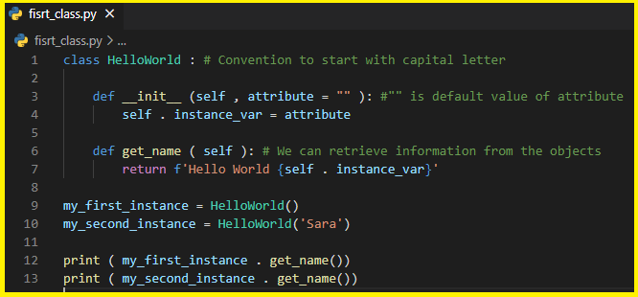

We created instances of the class in the following way:
instance = ClassName ('input argument ').
This calls the __init__ method of our class. This special method is called the constructor of the class.
instances
We assign the input string to the variable self.instance_var. The variable self refers to the instance itself. The self argument needs to be present when defining the method in the class, but it is passed automatically when calling the method and is therefore omitted both when creating new objects (using the special method __init__ ), and when calling other methods (for example the get_variable).

Slide 11
You should begin each syllable of your class names with an uppercase letter. Omit the underscores that would otherwise separate syllables in the usual Python naming convention, like, FirstClass, SeqRecord, NuclSequence. Practice 2 1. Create a class with the attributes name and seq. 2. Create an instance of this class and then print its name and sequence. As an input, take "MBG234Gag1", "AGCTGTCGGTAAGTCGAGT" as name and seq respectively.

Slide 12
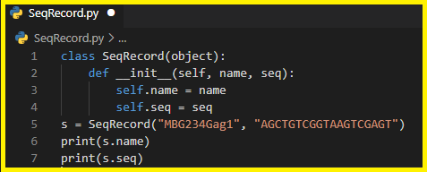

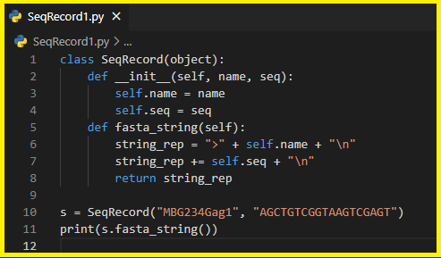

Now let’s add some functionality

Slide 13
A useful class Now we will build a class representing a nucleotide sequence, step by step. It will contain the sequence itself, but it will also provide methods that can be used to retrieve valuable information about the sequence. Practice 3 1. Create a class named NuclSequence and assign a sequence to it. Make an instance of this class named seq_object and print it. Take 'ACGTATAGCTAG ' as an input. 2. Give your sequence class a more sensible string representation, i.e., change how its objects will be displayed when for example it is printed. Hint: Use __str__method. The __str__ method in Python represents the class objects as a string.

Slide 14
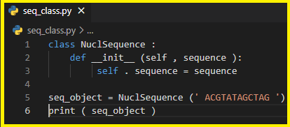
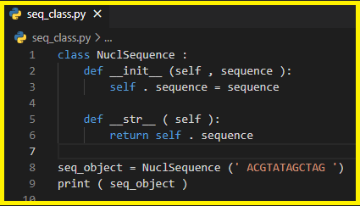
1.
2.
We will assign some useful methods to this class..

Slide 15
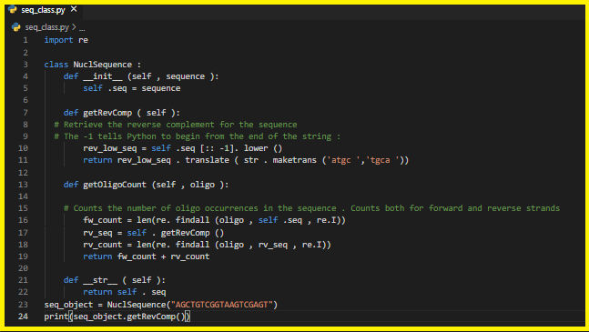

Slide 16
Using our sequence class Practice 4
Calculate the total number of oligo occurrences on both forward and reverse strands in an one-lined fasta file. Use the file name use_seq_class.py for your program.

Slide 17
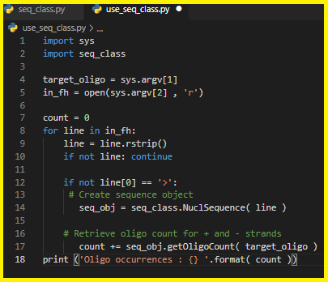
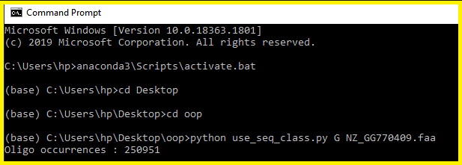
Some Outputs

Slide 18
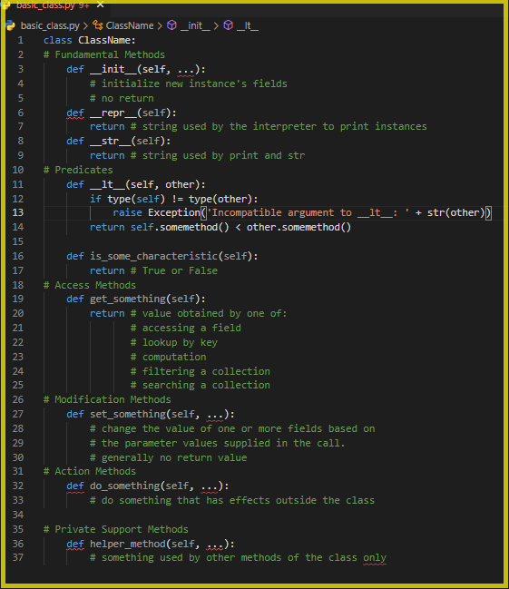
Basic Class in Summary (Template) This is a high-level outline of the organization of a typical basic class definition. With the exception of the fundamental methods listed first, there may be any number of methods in each category .

Slide 19
Implement a Gene inheritance model combining DNA
Practice 5 1. Create a class representing a person. It has an attribute called “genes” which is string of letters. Each character is a gene. 2. Implement the + operator on genes that will create a new “Person” and for the gene will select one randomly from each parent.
a = Person('ABC') b = Person('DEF') c = a + b
print(c.gene) # AB

Slide 20
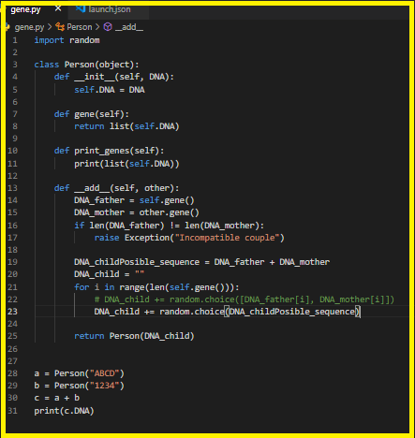



Some Outputs

Slide 21
What Are Inheritance and Composition?
Inheritance and composition are two major concepts in object-oriented programming that model the relationship between two classes. They drive the design of an application and determine how the application should evolve as new features are added or requirements change.
When you have a Derived class that inherits from a Base class, you created a relationship where Derived is a specialized version of Base.
Can you give some real-world examples of inheritance programming?
Base
extends
Derived
Note: In an inheritance relationship:
Classes that inherit from another are called derived classes, subclasses, or subtypes.
Classes from which other classes are derived are called base classes or super classes.
A derived class is said to derive, inherit, or extend a base class.

Slide 22
Inheritance
Let’s say you have a base class “Dog class” has a class attribute called species with the value of “Canis familiaris”
and you derive from it to create a Dachshund class. The inheritance relationship states that a Dachshund is a Dog (Canis familiaris). This means that Dachshund inherits the interface and implementation of Dog, and Dachshund objects can be used to replace Dog objects in the application.
What’s Composition?
Composition is a concept that models a has a relationship. It enables creating complex types by combining objects of other types. This means that a class Composite as containing an object of another class Component. This relationship means that a Composite has a Component.
Note: Classes that contain objects of other classes are usually referred to as composites, where classes that are used to create more complex types are referred to as components.

Slide 23
Practice 6
Create a class named Dog that has a attribute called species with the value of “Canis familiaris” (species = "Canis familiaris"). This class has two methods, __init__(self, name, age) and __str__(self) that return f"{self.name} is {self.age} years old“.
Create three subclasses JackRussellTerrier, Dachshund and Bulldog.
Print some outputs: jim, 5 years old, Bullddog, buddy, 9 years old, Dachshund
Class Dog
(Base class)
Class
JackRussellTerrier
(Child class)
Class
Dachshund
(Child class)
Class
Bulldog
(Child class)

Slide 24
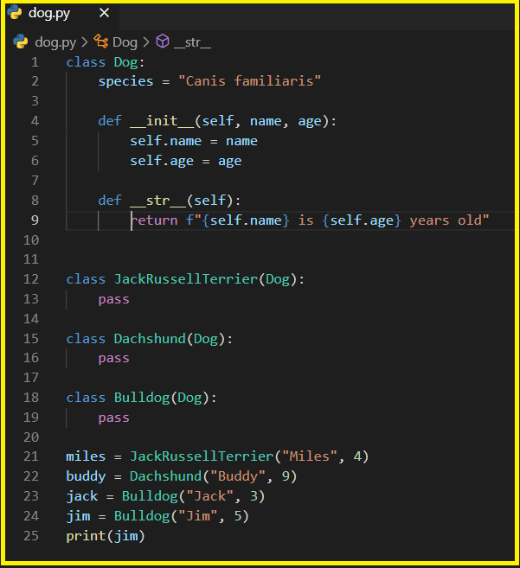


Slide 25
In summary, inheritance is a way to reuse codes between related classes that are commonly used.
Practice 7
Create a class called Sequence (base class or parent class) that contains three methods: __init__(), getSubSequenceCount() (which takes a sequence and a subsequence, and returns the number of subsequence occurrences in the sequence. You'll need to pass the flag parameter re.I for case-insensitivity) and __str__().
Create a class (subclass or child class) NuclSequenceSub representing nucleotide sequence that contains three methods __init__(), getRevComp () ( it retrieve the reverse complement for the sequence), and getOligoCount () (it counts the number of oligo occurrence in the sequence).
Create a class (subclass) AminoSequence with two methods,__init__() and getPeptideCounts that counts number of target peptide occurance in the sequence.
Note: Place the common code in the super class, and the specific code in the sub classes.
Use super () function to call the constructor of the super class Sequence, passing in the sequence variable as argument (super (). __init__ ( sequence)). In the simplest case, the super() function can be used to replace the explicit call BaseClass(Parent).__init__(self) .

Slide 26
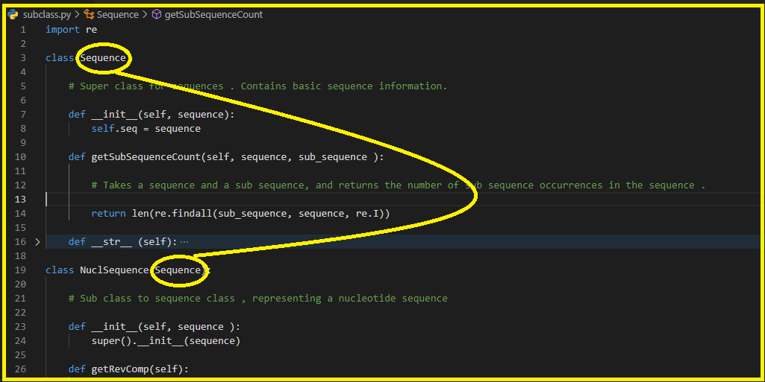
…

Slide 27
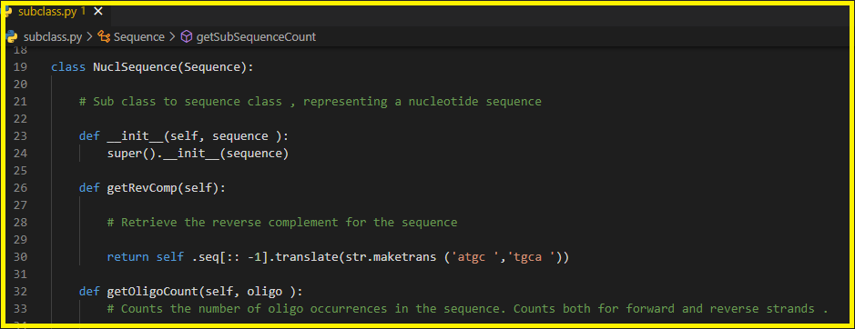
…

Slide 28
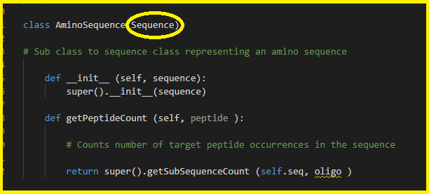

Slide 29
Supporting Materials: Please click on the topics to be directed to the websites that were used in this Powerpoint OOP, Class Definition Class Example (Car) Tetris game Pokémon game (Video) Practice 1, 2 Practice 3, 4, 6, PythonExtended.pdf Practice 5 Inheritance and Composition

